Slide 1

Encapsulation

Slide 2
What is encapsulation :
Encapsulation is one of the four fundamental OOP concepts. The other three are inheritance, polymorphism, and abstraction.

Slide 3
Advantages of Encapsulation in Java
Getter and Setter Methods – Private member can only be accessed within the same class. An outside class can not access the data members of that class. If you need to access these variables, you have to use public “getter” and “setter” methods.
Flexibility – With this, we can make the data as read-only or write-only as we require it to be. It also improves the maintainability and flexibility of code.
Reusability – It allows the user to a programmer to use the existing code again and again in an effective way.
Testing of the code – Ease of testing becomes easy. So it is better for Unit testing

Slide 4
Benefits of Encapsulation
The fields of a class can be made read-only or write-only.
A class can have total control over what is stored in its fields.

Slide 5
To achieve encapsulation in Java −
Declare the variables of a class as private.
Provide public setter and getter methods to modify and view the variables values.

Slide 6
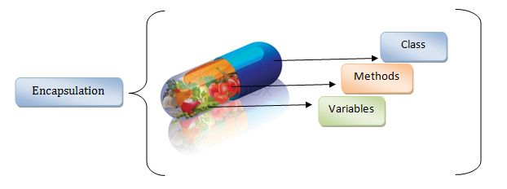
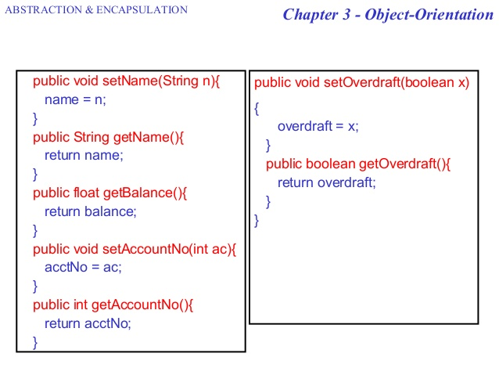
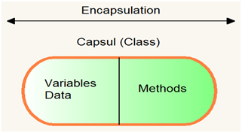
Real life Example :

Slide 7
Example by code :
private String name;
private String idNum;
private int age;
public int getAge() {
return age;
}
public String getName() {
return name;
}
public String getIdNum() {
return idNum;
}
public void setAge( int newAge) {
age = newAge;
}
public void setName(String newName) {
name = newName;
}
public void setIdNum( String newId) {
idNum = newId;
}
}

Slide 8
The public setXXX() and getXXX() methods are the access points of the instance variables of the EncapTest class. Normally, these methods are referred as getters and setters. Therefore, any class that wants to access the variables should access them through these getters and setters.
public class RunEncap {
public static void main(String args[]) {
EncapTest encap = new EncapTest();
encap.setName("James");
encap.setAge(20);
encap.setIdNum("12343ms");
System.out.print("Name : " + encap.getName() + " Age : " + encap.getAge());
}
}

Slide 9
Java Package

Slide 10
What is Package ?
A java package is a group of similar types of classes, interfaces and sub-packages.

Slide 11
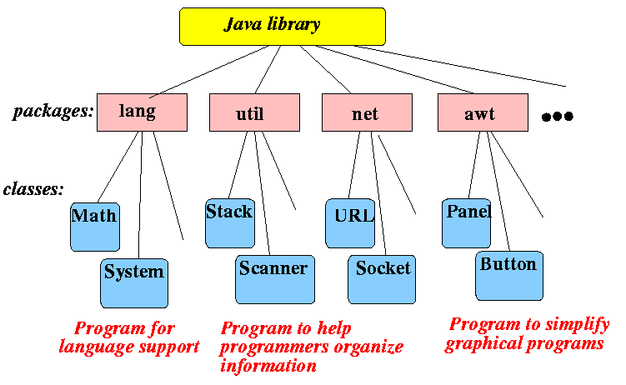
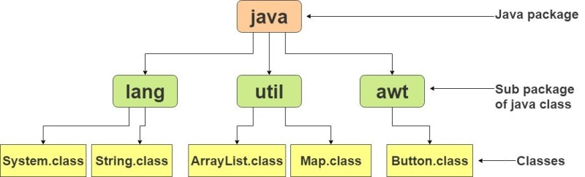
Real life example in Package

Slide 12
How to access package from another package?
import package.*;
import package.classname;
fully qualified name.

Slide 13
Access Modifiers in Java

Slide 14
What is access modifiers in java
There are two types of modifiers in Java: access modifiers and non-access modifiers.

Slide 15
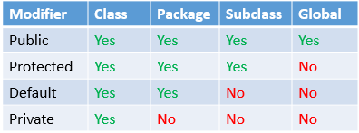
Real life example :

Slide 16
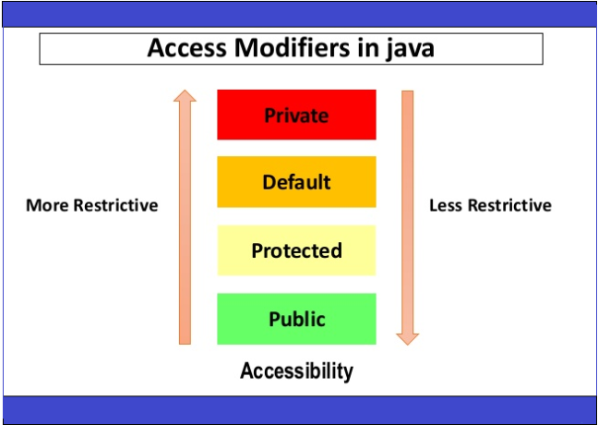
Access Modifiers in Java

Slide 17
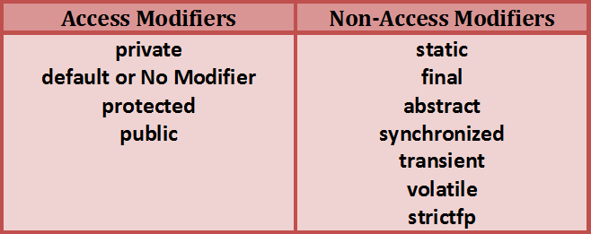
Access modifiers & non-access modifiers :

Slide 18
Thank You
For watching
My lecture

